Slide 1
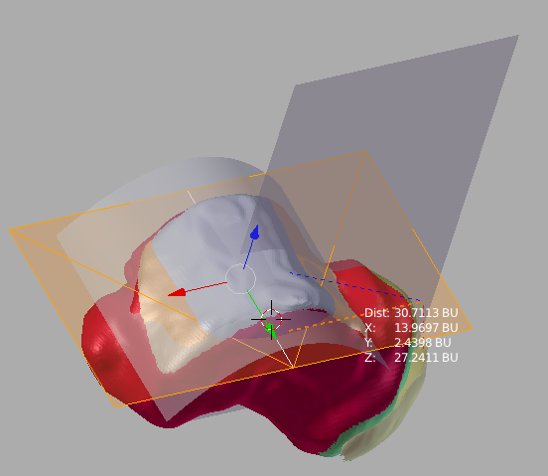
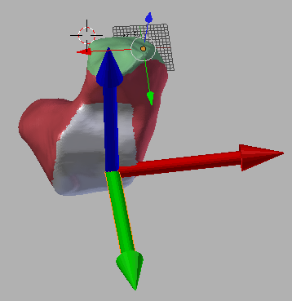
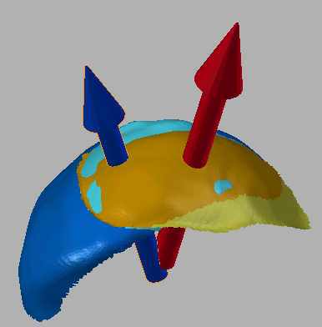
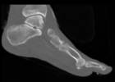
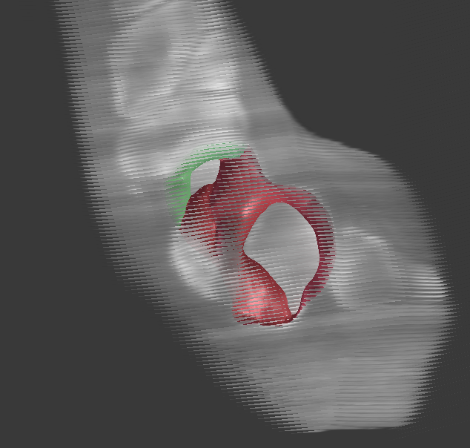
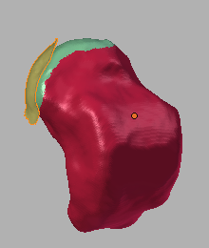
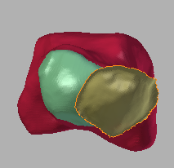
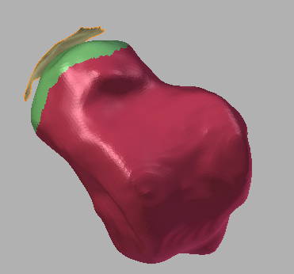
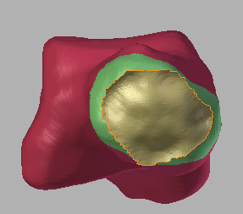
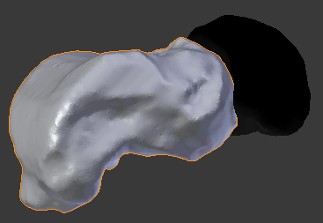
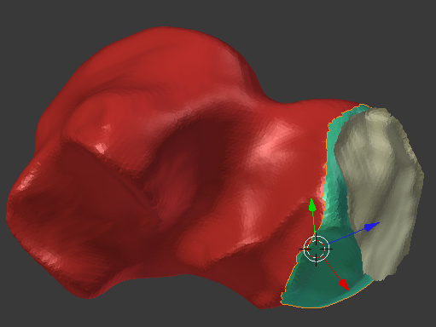
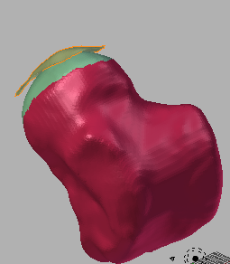
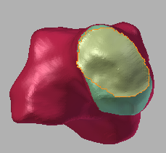
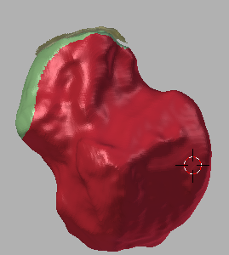
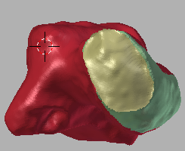
Talonavicular Joint Coverage and Talar Morphology Over Different Foot Types
Philip K. Louie^{1,2}, William R. Ledoux^{1,3,4}, Michael J. Fassbind^{1,3}, Bruce J. Sangeorzan^{1,4}
¹VA RR&D Center of Excellence for Limb Loss Prevention and Prosthetic Engineering, Seattle, WA, ²School of Medicine, University of WA, Seattle, WA,
Departments of ³Mechanical Engineering and ⁴Orthopaedics & Sports Medicine, University of Washington, Seattle, WA
INTRODUCTION
The pes planus and pes cavus foot deformities, as well as talonavicular joint arthritis can present with extreme pain causing deficits in balance and mobility. Characterization of the talonavicular joint coverage and talus morphology will aid in exploring the effects of various surgical and conservative treatment options as well as determining which feet are at greater risk of subsequent talonavicular joint arthritis.
METHODS: Talar Measurements and Positional Relationships
RESULTS
Foot Type
% Joint
Coverage¹
TL/TW²
TL/TH²
Hyperbolic or elliptic parabaloid was fit to talocrural joint.
The fit shape was used to imbed a coordinate system.
2 planes created along 2 axes of the coordinate system to measure dimensions.
Pes Cavus
Neutrally Aligned
Pes Planus
68.10* 1.512 1.764
75.45 1.432 1.748
71.16 1.436 1.781
PURPOSE
The purpose of this study is to develop 3D computer models of the talonavicular joint to observe biomechanical differences in multiple planes among pes cavus, neutrally aligned, and pes planus feet. In addition, variations in talar morphology.
We hypothesize that flat feet will have less talonavicular coverage than neutrally aligned or high arched feet. In addition, we hypothesize that talar morphology will be altered among the different foot types.
*Significantly different from neutrally aligned
¹ partial analysis of 13 pes cavus, 19 neutrally algned, and 26 pes planus
² partial analysis of 6 pes cavus, 6 neutrally aligned, and 10 pes planus
Coordinate systems were imbedded in both the talus head and body
Axes used to detemine the angular rotation of the talus head to the talus body
CONCLUSIONS
Position of navicular differ between the different foot types
Reduced joint coverage in pes cavus and pes planus feet when compared to neutrally aligned
Pes cavus feet trend towards being longer and narrower than neutrally algined and pes planus
METHODS: Joint Coverage
A
B
M
L
L
M
M
L
L
M
SIGNIFICANCE
Characterization of the talonavicular joint coverage and talus morphology will aid in exploring the effects of various surgical and conservative treatment options as well as determining which feet are at greater risk of subsequent talonavicular joint arthritis.
Pes Cavus
Neutrally Aligned
C
D
M
L
L
M
M
L
L
M
ACKNOWLEDGEMENTS
- University of Washington School of Medicine Medical School Research Training Program (MSRTP)
- VA RR&D Grant A4843C
- Members of the lab
(A) CT Scan, (B) Simulated Volumetric data, (C) Segmented Talus and Navicular Bone Surfaces, (D) Talus and Navicular Joint Surfaces
Asymptomatic Pes Planus
Symptomatic Pes Planus

